Slide 1
OPERATING SYSTEM
Name: Dr. Rita Roy
Assistant Professor
Department of CSE
GITAM School of Technology (GST)
Visakhapatnam – 530045

Slide 2
CHAPTER -1
UNIT 1 Operating system Structures: 8 hours
Introduction: What operating systems do, computer system organization, computer system architecture, operating system structure, resource management, Protection and security, kernel data structures.
Operating system Structures: operating system services, system calls, loaders and linkers, operating system structure, building and booting an operating system.

Slide 3
Introduction:
What operating systems do?
A computer system can be divided roughly into
four components: the hardware, the operating system, the application programs, and the users.
The hardware—the central processing unit (CPU), the memory, and the input/output (I/O) devices—provides the basic computing resources for the system.
The application programs—such as word processors, spreadsheets, compilers, and web browsers—define the ways in which these resources are used to solve users' computing problems.

Slide 4
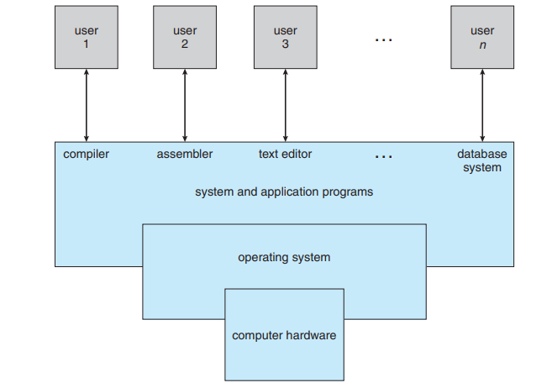
Contd…
Abstract view of the components of a computer system

Slide 5
Contd…
User View:
The user's view of the computer varies according to the interface being used. Most computer users sit in front of a PC, consisting of a monitor, keyboard, mouse, and system unit. Such a system is designed for one user to monopolize its resources.
Performance is, of course, important to the user; but rather than resource utilization, such systems are optimized for the single-user experience.

Slide 6
In other cases, a user sits at a terminal connected to a mainframe or minicomputer. Other users are accessing the same computer through other terminals.
These users share resources and may exchange information.
The operating system in such cases is designed to maximize resource utilization— to assure that all available CPU time, memory, and I/O are used efficiently and that no individual user takes more than her/his fair share.
In still other cases, users sit at workstations connected to networks of other workstations and servers.
These users have dedicated resources at their disposal, but they also share resources such as networking and servers—file, compute, and print servers.

Slide 7
Many varieties of handheld computers have come into fashion. Most of these devices are standalone units for individual users.
Some are connected to networks, either directly by wire or (more often) through wireless modems and networking. Because of power, speed, and interface limitations, they perform relatively few remote operations.
System View:
From the computer's point of view, the operating system is the program most intimately involved with the hardware. In this context, we can view an operating system as a resource allocator.

Slide 8
A computer system has many resources that may be required to solve a problem: CPU time, memory space, file-storage space, I/O devices, and so on.
The operating system acts as the manager of these resources.
Facing numerous and possibly conflicting requests for resources, the operating system must decide how to allocate them to specific programs and users so that it can operate the computer system efficiently and fairly.
A control program manages the execution of user programs to prevent errors and improper use of the computer. It is especially concerned with the operation and control of I/O devices.

Slide 9
1.3 Defining Operating Systems
An Operating System (OS) is an interface between a computer user and computer hardware.
An operating system is a software which performs all the basic tasks like file management, memory management, process management, handling input and output, and controlling peripheral devices such as disk drives and printers.
An operating system is software that enables applications to interact with a computer's hardware. The software that contains the core components of the operating system is called the kernel.

Slide 10
Definition 1: An Operating System is the low-level software that supports a computer's basic functions, such as scheduling tasks and controlling peripherals.
Or
Definition 2: An operating system is a program that acts as an interface between the user, the computer hardware and controls the execution of all kinds of programs.

Slide 11
0th Generation:
The term 0th generation is used to refer to the period of development of computing when Charles Babbage invented the Analytical Engine and later John Atanasoff created a computer in 1940.
First Generation (1951-1956):
The first generation marked the beginning of commercial computing including the introduction of Eckert and Mauchly’s UNIVAC I in early 1951, and a bit later, the IBM 701.
Second Generation (1956-1964):
The second generation of computer hardware was most notably characterized by transistors replacing vacuum tubes as the hardware component technology. The first operating system GMOS was developed by the IBM computer.

Slide 12
GMOS was based on single stream batch processing system, because it collects all similar jobs in groups or batches and then submits the jobs to the operating system using a punch card to complete all jobs in a machine.
Third Generation (1964-1979):
The third generation officially began in April 1964 with IBM’s announcement of its System/360 family of computers. Hardware technology began to use integrated circuits (ICs) which yielded significant advantages in both speed and economy.
Fourth Generation (1979 – Present):
The fourth generation is characterized by the appearance of the personal computer and the workstation. The component technology of the third generation, was replaced by very large scale integration (VLSI).

Slide 13
Following are some of important functions of an operating System.
Memory Management
Processor Management
Device Management
File Management
Network Management
Security
Control over system performance
Job accounting
Error detecting aids
Coordination between other software and users

Slide 14
1.2. Computer system organization
1.2.1: Computer-System Operation:
A modern general-purpose computer system consists of one or more CPUs and a number of device controllers connected through a common bus that provides access to shared memory.
The CPU and the device controllers can execute concurrently, competing for memory cycles. To ensure orderly access to the shared memory, a memory controller is provided whose function is to synchronize access to the memory.

Slide 15
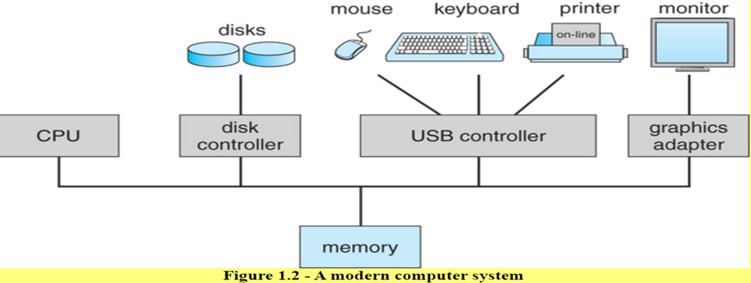

Slide 16
This initial program, or bootstrap program, tends to be simple.
Typically, it is stored in read-only memory (ROM) or electrically erasable programmable read-only memory (EEPROM), known by the general term firmware, within the computer hardware.
The bootstrap program must know how to load the operating system and to start executing that system.
To accomplish this goal, the bootstrap program must locate and load into memory the operating system kernel.

Slide 17
The occurrence of an event is usually signaled by an interrupt from either the hardware or the software.
Hardware may trigger an interrupt at any time by sending a signal to the CPU, usually by way of the system bus.
Software may trigger an interrupt by executing a special operation called a system call (also called a monitor call).
When the CPU is interrupted, it stops what it is doing and immediately transfers execution to a fixed location.
The fixed location usually contains the starting address where the service routine for the interrupt is located.

Slide 18
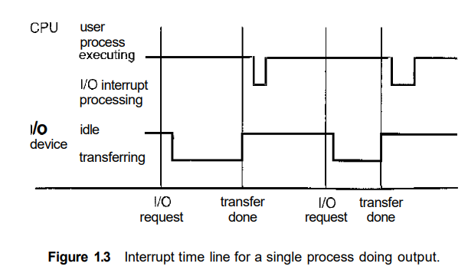
The interrupt service routine executes; on completion, the CPU resumes the interrupted computation.

Slide 19
The straightforward method for handling this transfer would be to invoke a generic routine to examine the interrupt information; the routine, in turn, would call the interrupt-specific handler. However, interrupts must be handled quickly.
The interrupt routine is called indirectly through the table, with no intermediate routine needed. Generally, the table of pointers is stored in low memory (the first 100 or so locations).
These locations hold the addresses of the interrupt service routines for the various devices.

Slide 20
If the interrupt routine needs to modify the processor state—for instance, by modifying register values—it must explicitly save the current state and then restore that state before returning.
After the interrupt is serviced, the saved return address is loaded into the program counter, and the interrupted computation resumes as though the interrupt had not occurred.
1.2.2 Storage Structure:
Computer programs must be in main memory (also called random-access memory or RAM) to be executed. Main memory is the only large storage area (millions to billions of bytes) that the processor can access directly. It commonly is implemented in a semiconductor technology called dynamic random-access memory (DRAM), which forms an array of memory words.

Slide 21
A typical instruction-execution cycle, as executed on a system with a von Neumann architecture, first fetches an instruction from memory and stores that instruction in the instruction register.
The programs and data to reside in main memory permanently. This arrangement usually is not possible for the following two reasons:
1. Main memory is usually too small to store all needed programs and data permanently.
2. Main memory is a volatile storage device that loses its contents when power is turned off or otherwise lost.

Slide 22
The most common secondary-storage device is a magnetic disk, which provides storage for both programs and data.
Most programs (web browsers, compilers, word processors, spreadsheets, and so on) are stored on a disk until they are loaded into memory.
Many programs then use the disk as both a source and a destination of the information for their processing.

Slide 23
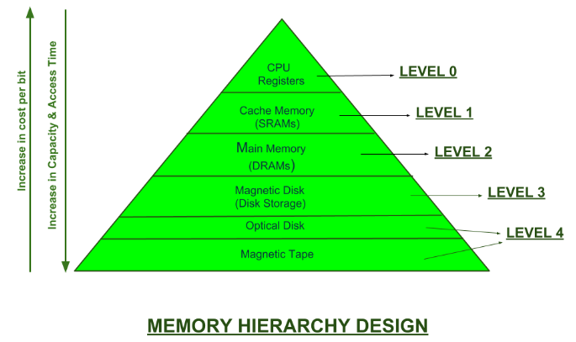
The wide variety of storage systems in a computer system can be organized in a hierarchy according to speed and cost. The higher levels are expensive, but they are fast.

Slide 24
Volatile storage loses its contents when the power to the device is removed.
In the absence of expensive battery and generator backup systems, data must be written to nonvolatile storage for safekeeping.
An electronic disk can be designed to be either volatile or non-volatile. During normal operation, the electronic disk stores data in a large DRAM array, which is volatile.
If external power is interrupted, the electronic-disk controller copies the data from RAM to the magnetic disk.

Slide 25
When external power is restored, the controller copies the data back into the RAM.
Another form of electronic disk is flash memory, which is popular in cameras and personal digital assistants (PDAs), in robots, and increasingly as removable storage on general-purpose computers.
Flash memory is slower than DRAM but needs no power to retain its contents.

Slide 26
I/O Structure:
Storage is only one of many types of I/O devices within a computer.
A large portion of operating system code is dedicated to managing I/O, both because of its importance to the reliability and performance of a system and because of the varying nature of the devices. Therefore, we now provide an overview of I/O.

Slide 27
Computer-System Architecture
Single-Processor Systems:
The variety of single-processor systems may be surprising, however, since these systems range from PDAs through mainframes.
On a single-processor system, there is one main CPU capable of executing a general-purpose instruction set, including instructions from user processes.
They may come in the form of device-specific processors, such as disk, keyboard, and graphics controllers; or, on mainframes.

Slide 28
They may come in the form of more general-purpose processors, such as I/O processors that move data rapidly among the components of the system.
For example, a disk-controller microprocessor receives a sequence of requests from the main CPU and implements its own disk queue and scheduling algorithm.
This arrangement relieves the main CPU of the overhead of disk scheduling. PCs contain a microprocessor in the keyboard to convert the keystrokes into codes to be sent to the CPU.

Slide 29
Multiprocessor Systems:
Single-processor systems are most common, multiprocessor systems(also known as parallel systems or tightly coupled systems) are growing in importance.
Such systems have two or more processors in close communication, sharing the computer bus and sometimes the clock, memory, and peripheral devices.
Multiprocessor systems have three main advantages:

Slide 30
1. Increased throughput:
By increasing the number of processors, we expect to get more work done in less time.
The speed-up ratio with N processors is not N, however; rather, it is less than N. When multiple processors cooperate on a task, a certain amount of overhead is incurred in keeping all the parts working correctly.
This overhead, plus contention for shared resources, lowers the expected gain from additional processors. Similarly, N programmers working closely together do not produce N times the amount of work a single programmer would produce.

Slide 31
2. Increased reliability:
If functions can be distributed properly among several processors, then the failure of one processor will not halt the system, only slow it down.
If we have ten processors and one fails, then each of the remaining nine processors can pick up a share of the work of the failed processor.
Thus, the entire system runs only 10 percent slower, rather than failing altogether.

Slide 32
Economy of scale:
Multiprocessor systems can cost less than equivalent multiple single-processor systems, because they can share peripherals, mass storage, and power supplies.
If several programs operate on the same set of data, it is cheaper to store those data on one disk and to have all the processors share them than to have many computers with local disks and many copies of the data.

Slide 33
Increased reliability of a computer system is crucial in many applications.
The ability to continue providing service proportional to the level of surviving hardware is called graceful degradation.
Some systems go beyond graceful degradation and are called fault tolerant, because they can suffer a failure of any single component and still continue operation.
The multiple-processor systems in use today are of two types.
Some systems use asymmetric multiprocessing, in which each processor is assigned a specific task.

Slide 34
A master processor controls the system; the other processors either look to the master for instruction or have predefined tasks.
This scheme defines a master-slave relationship. The master processor schedules and allocates work to the slave processors.
The most common systems use symmetric multiprocessing (SMP), in which each processor performs all tasks within the operating system.
SMP means that all processors are peers; no master-slave relationship exists between processors.

Slide 35
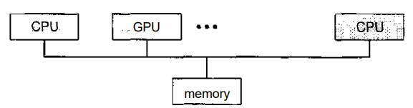

The benefit of this model is that many processes can run simultaneously—N processes can run if there are N CPUs—without causing a significant deterioration of performance.
However, we must carefully control I/O to ensure that the data reach the appropriate processor. Also, since the CPUs are separate, one may be sitting idle while another is overloaded, resulting in inefficiencies

Slide 36
The difference between symmetric and asymmetric multiprocessing may result from either hardware or software.
Special hardware can differentiate the multiple processors, or the software can be written to allow only one master and multiple slaves.
Blade servers are a recent development in which multiple processor boards, I/O boards, and networking boards are placed in the same chassis.
The difference between these and traditional multiprocessor systems is that each blade-processor board boots independently and runs its own operating system.
Some blade-server boards are multiprocessor as well, which blurs the lines between types of computers.

Slide 37
Clustered Systems:
Another type of multiple-CPU system is the clustered system. Like multiprocessor systems, clustered systems gather together multiple CPUs to accomplish computational work.
Clustered systems differ from multiprocessor systems, however, in that they are composed of two or more individual systems coupled together.

Slide 38
Clustering is usually used to provide high-availability service; that is, service will continue even if one or more systems in the cluster fail.
High availability is generally obtained by adding a level of redundancy in the system. A layer of cluster software runs on the cluster nodes.
Each node can monitor one or more of the others (over the LAN).
Clustering can be structured asymmetrically or symmetrically.
In asymmetric clustering, one machine is in hot-standby mode while the other is running the applications. The hot-standby host machine does nothing but monitor the active server.

Slide 39
In symmetric mode, two or more hosts are running applications, and are monitoring each other.
This mode is obviously more efficient, as it uses all of the available hardware. It does require that more than one application be available to run.
For example, Oracle Parallel Server is a version of Oracle's database that has been designed to run on a parallel cluster.
Each machine runs Oracle, and a layer of software tracks access to the shared disk.

Slide 40
Operating-System Structure
One of the most important aspects of operating systems is the ability to multiprogramming.
A single user cannot, in general, keep either the CPU or the I/O devices busy at all times.
Multiprogramming increases CPU utilization by organizing jobs (code and data) so that the CPU always has one to execute.

Slide 41
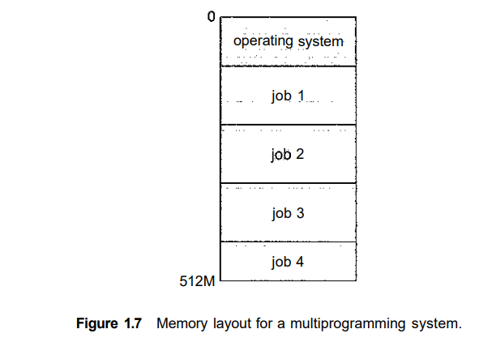
This set of jobs can be a subset of the jobs kept in the job pool—which contains all jobs that enter the system—since the number of jobs that can be kept simultaneously in memory is usually smaller than the number of jobs that can be kept in the job pool.

Slide 42
The operating system picks and begins to execute one of the jobs in memory. Eventually, the job may have to wait for some task, such as an I/O operation, to complete.
A lawyer does not work for only one client at a time, for example. While one case is waiting to go to trial or have papers typed, the lawyer can work on another case.
If he has enough clients, the lawyer will never be idle for lack of work. (Idle lawyers tend to become politicians, so there is a certain social value in keeping lawyers busy.)

Slide 43
Multi-programmed systems provide an environment in which the various system resources (for example, CPU, memory, and peripheral devices) are utilized effectively, but they do not provide for user interaction with the computer system.
Time sharing (or multitasking) is a logical extension of multiprogramming.
In time-sharing systems, the CPU executes multiple jobs by switching among them, but the switches occur so frequently that the users can interact with each program while it is running.

Slide 44
Time sharing requires an interactive (or hands-on) computer system, which provides direct communication between the user and the system.
The user gives instructions to the operating system or to a program directly, using a input device such as a keyboard or a mouse, and waits for immediate results on an output device.
Accordingly, the response time should be short—typically less than one second.
A time-shared operating system uses CPU scheduling and multiprogramming to provide each user with a small portion of a time-shared computer

Slide 45
Each user has at least one separate program in memory. A program loaded into memory and executing is called a process.
Time-sharing and multiprogramming require several jobs to be kept simultaneously in memory. Since in general main memory is too small to accommodate all jobs, the jobs are kept initially on the disk in the job pool.
This pool consists of all processes residing on disk awaiting allocation of main memory.

Slide 46
If several jobs are ready to be brought into memory, and if there is not enough room for all of them, then the system must choose among them. Making this decision is job scheduling.
If several jobs are ready to run at the same time, the system must choose among them. Making this decision is CPU scheduling.
In a time-sharing system, the operating system must ensure reasonable response time, which is sometimes accomplished through swapping, where processes are swapped in and out of main memory to the disk.
A more common method for achieving this goal is virtual memory, a technique that allows the execution of a process that is not completely in memory

Slide 47
Resource management
Process Management
A program in execution, as mentioned, is a process. A time-shared user program such as a compiler is a process.
A process needs certain resources—including CPU time, memory, files, and I/O devices—to accomplish its task.
A program is a passive entity, like the contents of a file stored on disk, whereas a process is an active entity.

Slide 48
A single-threaded process has one program counter specifying the next instruction to execute.(one instruction at most is executed on behalf of the process.)
A multithreaded process has multiple program counters, each pointing to the next instruction to execute for a given thread.
A system consists of a collection of processes, some of which are operating-system processes (those that execute system code) and the rest of which are user processes.

Slide 49
Process Management
The operating system is responsible for the following activities in connection with process management:
Scheduling processes and threads on the CPUs
Creating and deleting both user and system processes
Suspending and resuming processes
Providing mechanisms for process synchronization
Providing mechanisms for process communication

Slide 50
Memory Management
The central processor reads instructions from main memory during the instruction-fetch cycle and both reads and writes data from main memory during the data-fetch cycle.
For a program to be executed, it must be mapped to absolute addresses and loaded into memory.
As the program executes, it accesses program instructions and data from memory by generating these absolute addresses.

Slide 51
The operating system is responsible for the following activities in connection with memory management:
Keeping track of which parts of memory are currently being used and who is using them
Deciding which processes (or parts of processes) and data to move into and out of memory
Allocating and de-allocating memory space as needed

Slide 52
Storage Management:
The operating system abstracts from the physical properties of its storage devices to define a logical storage unit, the file.
The operating system maps files onto physical media and accesses these files via the storage devices.

Slide 53
File-System Management
Computers can store information on several different types of physical media. Magnetic disk, optical disk, and magnetic tape are the most common.
A file is a collection of related information defined by its creator. Commonly, files represent programs and data.
The operating system implements the abstract concept of a file by managing mass-storage media, such as tapes and disks, and the devices that control them.
In addition, files are normally organized into directories to make them easier to use.

Slide 54
File-System Management
The operating system is responsible for the following activities in connection with file management:
Creating and deleting files
Creating and deleting directories to organize files
Supporting primitives for manipulating files and directories
Mapping files onto secondary storage
Backing up files on stable (nonvolatile) storage media.

Slide 55
Storage Management
Mass-Storage Management
Most modern computer systems use disks as the principal on-line storage medium for both programs and data.
Most programs—including compilers, assemblers, word processors, editors, and formatters—are stored on a disk until loaded into memory.

Slide 56
The operating system is responsible for the following activities in connection with disk management:
Free-space management
Storage allocation
Disk scheduling

Slide 57
Caching
Caching means information is normally kept in some storage system (such as main memory).
As it is used, it is copied into a faster storage system—the cache—on a temporary basis. When we need a particular piece of information, we first check whether it is in the cache.
If it is, we use the information directly from the cache.

Slide 58
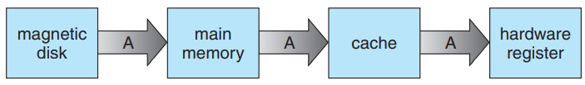
If it is not, we use the information from the source, putting a copy in the cache under the assumption that we will need it again soon.
Because caches have limited size, cache management is an important design problem.
Main memory can be viewed as a fast cache for secondary storage.
Migration of integer A from disk to register

Slide 59
Caching
In a computing environment where only one process executes at a time, this arrangement poses no difficulties, since an access to integer A will always be to the copy at the highest level of the hierarchy.
The situation becomes more complicated in a multiprocessor environment where, in addition to maintaining internal registers, each of the CPUs also contains a local cache.
In such an environment, a copy of A may exist simultaneously in several caches.
This situation is called cache coherency, and it is usually a hardware issue.

Slide 60
I/O Systems
The I/O subsystem consists of several components:
A memory-management component that includes buffering, caching, and spooling
A general device-driver interface
Drivers for specific hardware devices

Slide 61
Protection and Security
If a computer system has multiple users and allows the concurrent execution of multiple processes, then access to data must be regulated.
For that purpose, mechanisms ensure that files, memory segments, CPU, and other resources can be operated on by only those processes that have gained proper authorization from the operating system.
For example, memory-addressing hardware ensures that a process can execute only within its own address space.

Slide 62
Protection, then, is any mechanism for controlling the access of processes or users to the resources defined by a computer system.
This mechanism must provide means for specification of the controls to be imposed and means for enforcement.
Protection can improve reliability by detecting latent errors at the interfaces between component subsystems.
Protection, then, is any mechanism for controlling the access of processes or users to the resources defined by a computer system.

Slide 63
This mechanism must provide means for specification of the controls to be imposed and means for enforcement.
Protection can improve reliability by detecting latent errors at the interfaces between component subsystems.
Early detection of interface errors can often prevent contamination of a healthy subsystem by another subsystem that is malfunctioning.

Slide 64
Operating-System Services
An operating system provides an environment for the execution of programs. It provides certain services to programs and to the users of those programs.
The specific services provided, of course, differ from one operating system to another, but we can identify common classes.
These operating-system services are provided for the convenience of the programmer, to make the programming task easier.
User interface:
i. Almost all operating systems have a user interface (UI). This interface can take several forms. One is a command-line interface (CLI), which uses text commands and a method for entering them

Slide 65
Another is a batch interface, in which commands and directives to control those commands are entered into files, and those files are executed. Most commonly/a graphical user interface (GUI) is used.
Program execution:
The system must be able to load a program into memory and to run that program. The program must be able to end its execution, either normally or abnormally (indicating error).
I/O operations: A running program may require I/O, which may involve a file or an I/O device. For specific devices, special functions may be desired (such as recording to a CD or DVD drive or blanking a CRT screen).

Slide 66
For efficiency and protection, users usually cannot control I/O devices directly. Therefore, the operating system must provide a means to do I/O.
File-system manipulation:
The file system is of particular interest. Programs need to read and write files and directories.
They also need to create and delete them by name, search for a given file, and list file information.

Slide 67
Communications:
There are many circumstances in which one process needs to exchange information with another process.
Such communication may occur between processes that are executing on the same computer or between processes that are executing on different computer systems tied together by a computer network.

Slide 68
Error detection:
The operating system needs to be constantly aware of possible errors.
Errors may occur in the CPU and memory hardware (such as a memory error or a power failure), in I/O devices (such as a parity error on tape, a connection failure on a network, or lack of paper in the printer), and in the user program (such as an arithmetic overflow, an attempt to access an illegal memory location, or a too-great use of CPU time).

Slide 69
Another set of operating-system functions exists not for helping the user but rather for ensuring the efficient operation of the system itself.
Resource allocation:
When there are multiple users or multiple jobs running at the same time, resources must be allocated to each of {hem. Many different types of resources are managed by the operating system. Some (such as CPU cycles, main memory, and file storage) may have special allocation code, whereas others (such as I/O devices) may have much more general request and release code.

Slide 70
Accounting: We want to keep track of which users use how much and what kinds of computer resources. This record keeping may be used for accounting (so that users can be billed) or simply for accumulating usage statistics.
Protection and security:
The owners of information stored in a multiuser or networked computer system may want to control use of that information.
When several separate processes execute concurrently, it should not be possible for one process to interfere with the others or with the operating system itself. Protection involves ensuring that all access to system resources is controlled.

Slide 71
Security of the system from outsiders is also important. Such security starts with requiring each user to authenticate himself or herself to the system, usually by means of a password, to gain access to system resources.
The job of security is to defend a system from external and internal attacks.
Such attacks spread across a huge range and include viruses and worms, denial-of service attacks (which use all of a system’s resources and so keep leGSTimate users out of the system), identity theft, and theft of service.
Most operating systems maintain a list of user names and associated user identifiers (user IDs).
In Windows parlance, this is a security ID (SID). These numerical IDs are unique, one per user.

Slide 72
Kernel Data Structures
An array is a simple data structure in which each element can be accessed directly. For example, main memory is constructed as an array.
A list represents a collection of data values as a sequence.
The most common method for implementing this structure is a linked list, in which items are linked to one another.
Linked lists are of several types:
In a singly linked list, each item points to its successor.

Slide 73
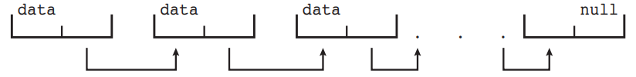
In a doubly linked list, a given item can refer either to its predecessor or to its successor.
In a circularly linked list, the last element in the list refers to the first element, rather than to null.
Singly linked list

Slide 74
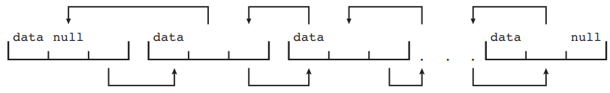
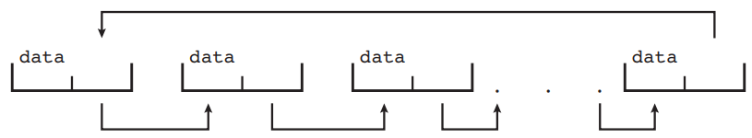
Lists, Stacks, and Queues
Doubly linked list
Circularly linked list
Linked lists accommodate items of varying sizes and allow easy insertion and deletion of items.

Slide 75
A stack is a sequentially ordered data structure that uses the last in, first out (LIFO) principle for adding and removing items, meaning that the last item placed onto a stack is the first item removed.
The operations for inserting and removing items from a stack are known as push and pop, respectively.
An operating system often uses a stack when invoking function calls.
A queue, in contrast, is a sequentially ordered data structure that uses the first in, first out (FIFO) principle: items are removed from a queue in the order in which they were inserted.

Slide 76
Example of queues in OS is jobs that are sent to a printer are typically printed in the order in which they were submitted.
TREES:
A tree is a data structure that can be used to represent data hierarchically. Data values in a tree structure are linked through parent–child relationships.
General Tree
Binary Tree
Binary search Tree
Balanced binary search tree

Slide 77
Hash Functions and Maps
A hash function takes data as its input, performs a numeric operation on this data, and returns a numeric value.
This numeric value can then be used as an index into a table (typically an array) to quickly retrieve the data.
One potential difficulty with hash functions is that two inputs can result in the same output value—that is, they can link to the same table location.
We can accommodate this hash collision by having a linked list at that table location that contains all of the items with the same hash value.

Slide 78
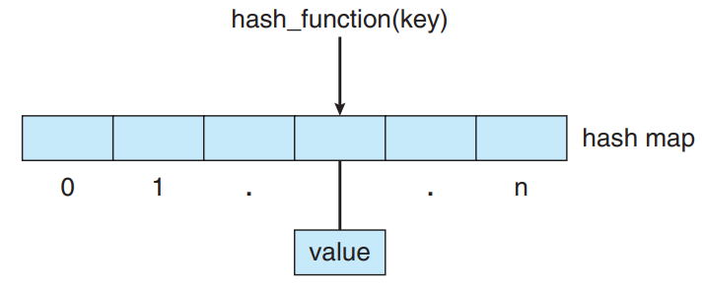
One use of a hash function is to implement a hash map, which associates (or maps) [key:value] pairs using a hash function.
Once the mapping is established, we can apply the hash function to the key to obtain the value from the hash map.

Slide 79
Bitmaps
A bitmap is a string of n binary diGSTs that can be used to represent the status of n items.
For example, suppose we have several resources, and the availability of each resource is indicated by the value of a binary diGST: 0 means that the resource is available, while 1 indicates that it is unavailable (or vice-versa).
The value of the i^{th} position in the bitmap is associated with the i^{th} resource.

Slide 80
Bitmaps
As an example, consider the bitmap shown below:
001011101
Resources 2, 4, 5, 6, and 8 are unavailable; resources 0, 1, 3, and 7 are available.

Slide 81
THANK YOU

